Slide 1
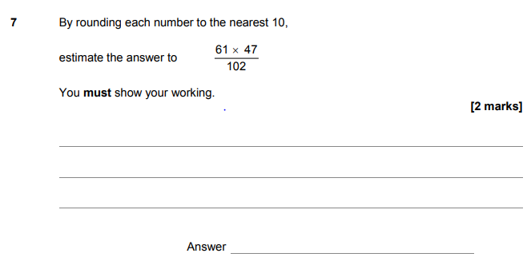
At GCSE
Notes:
Tracking back to primary … Rounding seeds are sown in Y2 and formally in Y3
Multiples of 10 start in Y1
Using place value to x/div by 10 and 100 starts in Y4
Multiplying 60 x 50 and dividing 3000 by 100 would be a Y5 expectation
Way it is written with the horizontal line is really the only bit that is beyond Y5 maths here
The report on this paper states:
Question 7 Most students did attempt an estimate although some attempts at a full accurate calculation were seen. It was quite common to see an error in the calculation 60 × 50 with very few ‘cancelling zeros’ to make the calculation easier.

Slide 2
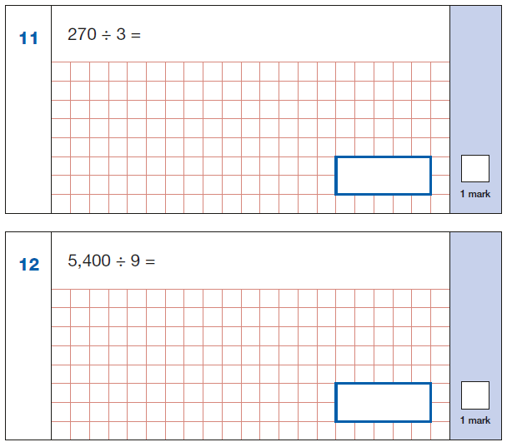
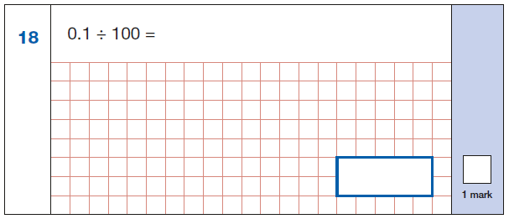
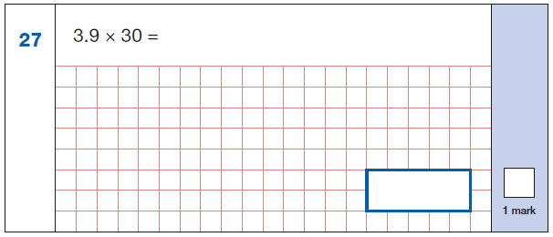
The importance of reasoning: Think before you calculate – apply what you know.
Notes:
From KS2 arithmetic paper 2018
It’s not just about number crunching – applying arithmetic laws – 3.9 x 30 = 3.9 x 10 x 3 = 3.9 x 3 x 10 (associative law?)
There is a clear move in KS2 SATs papers towards reasoning
The arithmetic paper is no longer just a chance to show off your written calculation strategies and successful students look at the numbers involved before then dive into a written method as there is often a simpler way. Spotting these questions save them time which can then be spent on the inevitable long multiplication and division questions later in the paper.

Slide 3
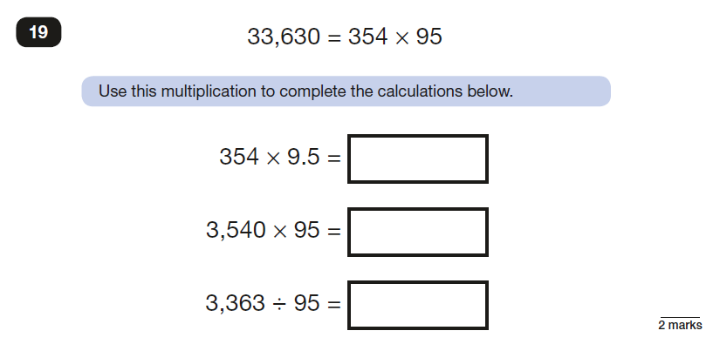
Notes:
What language do we use to talk about something like this? Is it the same at KS2 and 3?
Reasoning – using what you know to work out what you don’t
Understanding the structures of multiplication and division and what happens when you change the scale of a factor or a divisor
Understanding the role of the equals sign and that it doesn’t matter where it appears in the calculation/equation
Inverse relationship between multiplication and division.
Much more than just number crunching – (procedural) variation at work

Slide 4
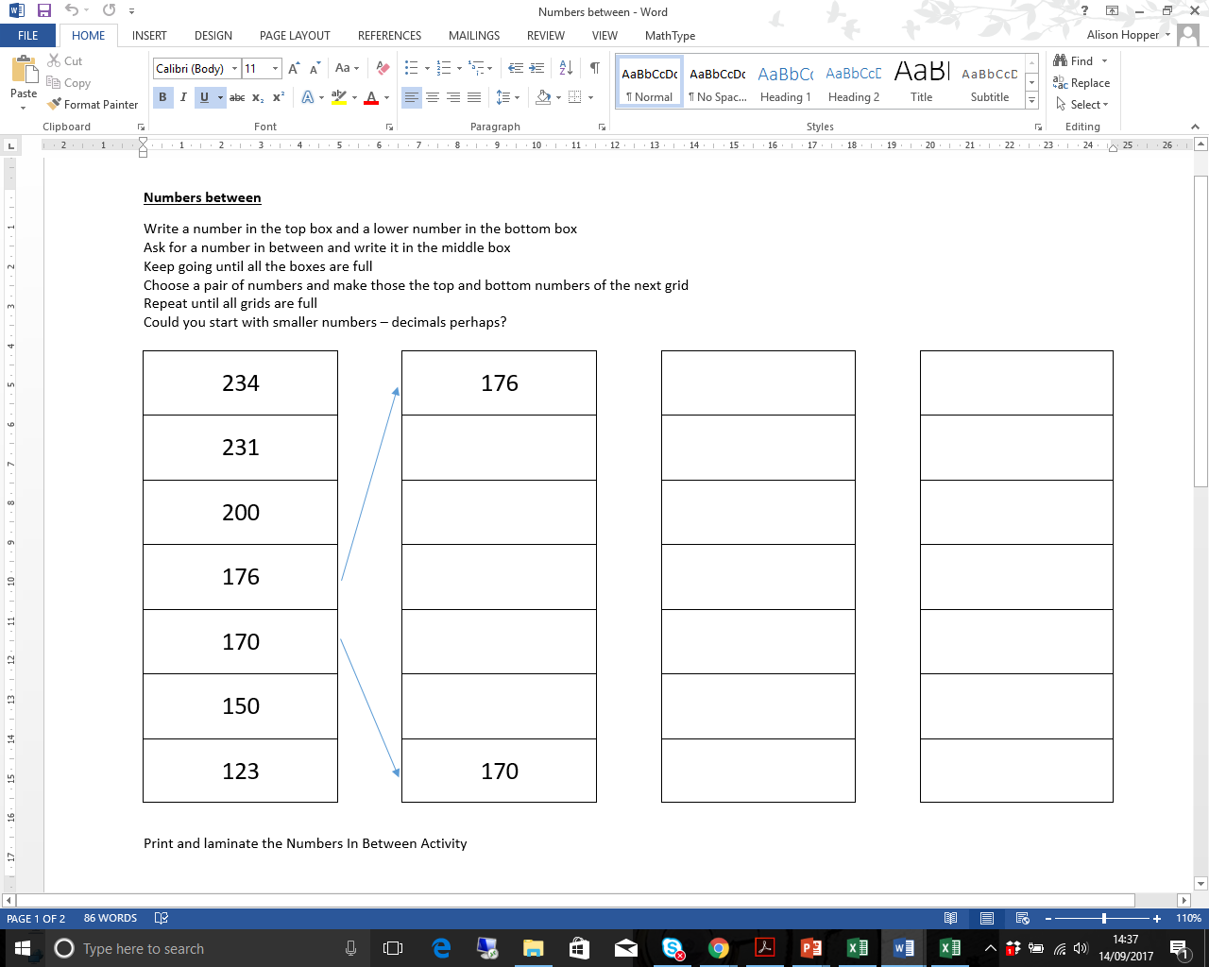
Place Value – Numbers Between
Year 7/10 Intervention Mentor Guides
Aim
The aim of this activity is to find numbers which are between a pair of given numbers. As the activity continues, the numbers get closer together and decimals are needed.
Take two neighbouring numbers from the middle of the list to become the top and bottom numbers of the next list. Continue across the lists and add more if you want to!
Possible Difficulties
You might have to remind the student that there are numbers between whole numbers. You could use the place value slider from another of the activities to demonstrate this. You could also draw a number line and ask the student what numbers are between e.g. 171 and 172 on a number line.
Remember that the numbers are going from biggest to smallest down the list!
Your student may use whole numbers only until they run out. You might what to encourage them to use a different strategy next time.
Your student may not be confident with decimals. You could turn this into a game where you take it in turns to write numbers in the boxes. The first person to have to write a decimal loses. This way you could encourage the student to talk about decimals without having to use them if they are not confident.
Questions to Ask
Is there a big gap between these numbers?
Which pair of numbers would you choose to have the biggest gap?
Are there enough whole numbers to fill the boxes in between?
What will we have to do if there aren’t?
What would be the most difficult numbers to have in the top and bottom boxes? Why would those be difficult?
What number is half way between these numbers? How could we work it out?
Going Deeper
Encourage the student to start with a list of decimal numbers all with the same ‘ones’ digit e.g. 3.45, 3.76, 3.91 etc.
Notes:
You have this activity on your table.
This, after an assessment loop, is the start of the place value set of resources.

Slide 5
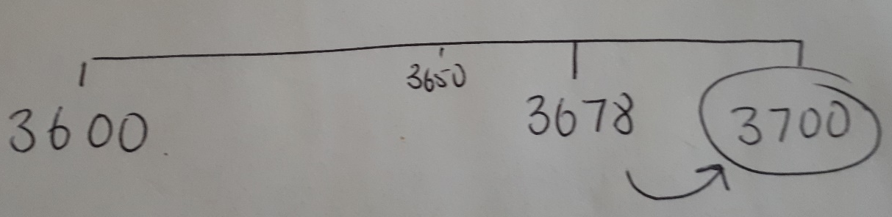
Place Value – Rounding Loop Cards
Year 7/10 Intervention Mentor Guides
Possible Difficulties
Students may not remember to look at the digit to the right of the one they are rounding to
Positioning numbers on a number line between the multiples of 10/100/1 000 on either side can support students in thinking about which one the number is closest to.
e.g. 3 678 rounded to the nearest 100
Putting in the number which is half way can also support the student
Sometimes students, when rounding to the nearest hundred, ignore any higher value digits so 3 678 rounded to the nearest hundred could become 700 and not 3 700. The number line can again help to address this misunderstanding.
Aim
The aim of these cards is to practice rounding numbers.
The first set looks at rounding whole numbers to the nearest 10, 100 or 1 000
The second set involves rounding decimals to tenths, hundredths, 1 or 2 decimal places. This is a more challenging set of cards and may not be suitable for your student certainly at the start of your work on place value.
Questions to Ask
Which digit are you looking at when you are rounding to the nearest ten (or hundred or thousand)?
How do you decide whether to round up or down?
Is there a rule or a way of remembering?
Children may talk about the ‘High 5’ rule which is often taught in Primary Schools (5 and above rounds up, 4 and below rounds down)
When is it useful to round numbers?
Think about times when you need to estimate
Notes:
An example of a mentor guide for the rounding loop card game.
Have a go at the rounding loop cards and think about what skills and understanding the children will need to have and what it is developing
What would you want to add to the guidance?
Are the cards allowing students to practice?

Slide 6
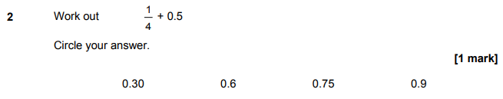
Which was the most popular wrong answer?
Notes:
0.9 was the most popular wrong answer – adding the 4 and the 5?
How would you want Y11 students to think about this question?

Slide 7
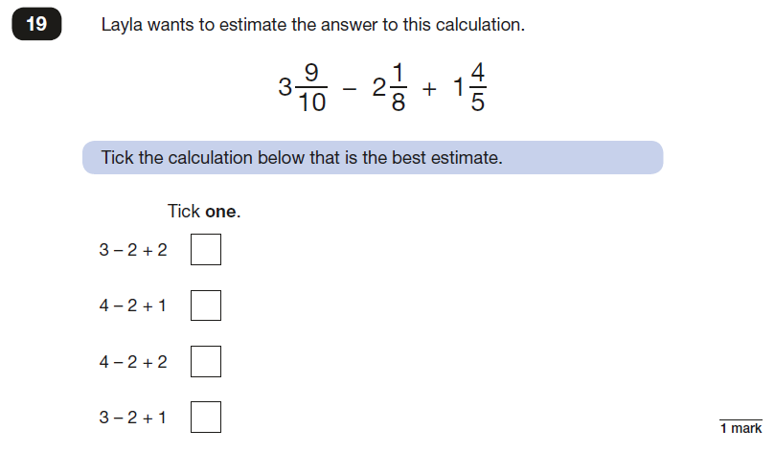
Reasoning and rounding
Notes:
Reasoning and rounding is again important here and realising which fractions are closest to 1 and that both 9/10 and 4/5 are closer to 1 than a half
Y5 and 6 children add fractions with the same and different denominators and mixed numbers
This question though is highlighting the need to understand what the fraction represents as a number in its own right and to see that rounding can be applied to fractions as well as to whole numbers and decimal fractions. Siegler research – there is an example.
We round decimals but do we round fractions?

Slide 8
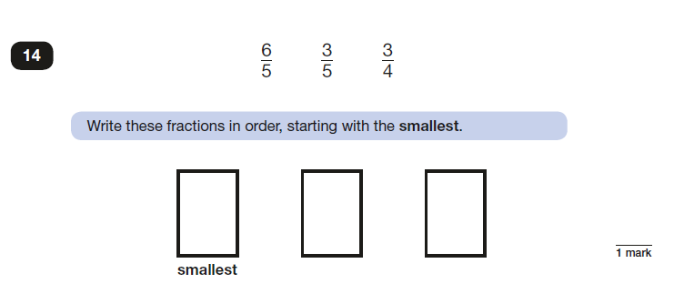
Reasoning
Notes:
Do you need to find a common denominator?
What would the ability to reason without finding one tell you about a child’s understanding of fractions?
No difference in the recognition of how a child got this right but you can learn a huge amount about their understanding.

Slide 9

What is the same and what is different?
Notes:
Order without finding a common denominator!
Do you need to find a common denominator?
What would the ability to reason without finding one tell you about a child’s understanding of fractions?
Do we go to procedure too quickly?
If you were able to reason your way through this, what would it help you to do in the future?
What understanding are we developing?

Slide 10
If you are interested …
… we are looking for schools interested in trialling materials.
Please get in touch:
alison.hopper@mei.org.uk
@AlisonHopper68

